Slide 1
RESTAURANT PoS
By
Richard Debrah
Richard Bates
Jim Reinknecht

Slide 2
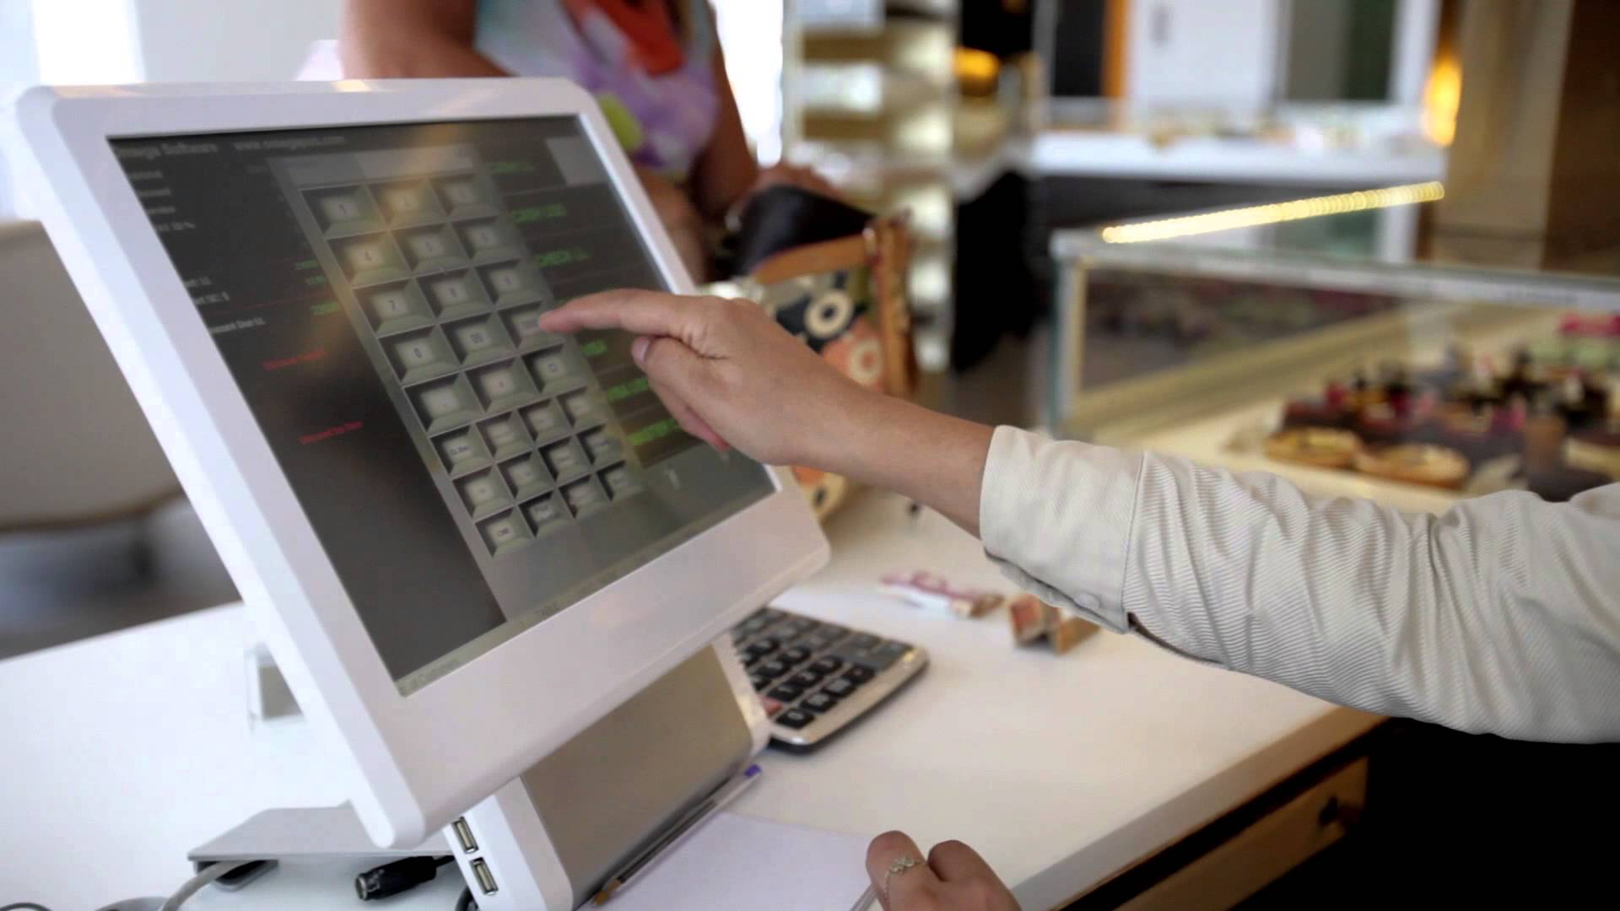
What is Restaurant PoS?
Restaurant PoS is a simple React application for managing restaurant seating.

Slide 3
Stuck on an old PoS? Choose Restaurant PoS.
Getting tied up in long-term (and inflexible) contracts?
If you discover your old PoS is not the best fit for your business, you can always switch with minimal hassle.
Not having a migration plan in place?
Works seamlessly on various database types so migration is easy

Slide 4
Choose Restaurant PoS cont…
Flexible and lightweight so you can run it on systems with super low memory.
Compatible with many browsers of all screen sizes.
We allow customization to allow easy

Slide 5
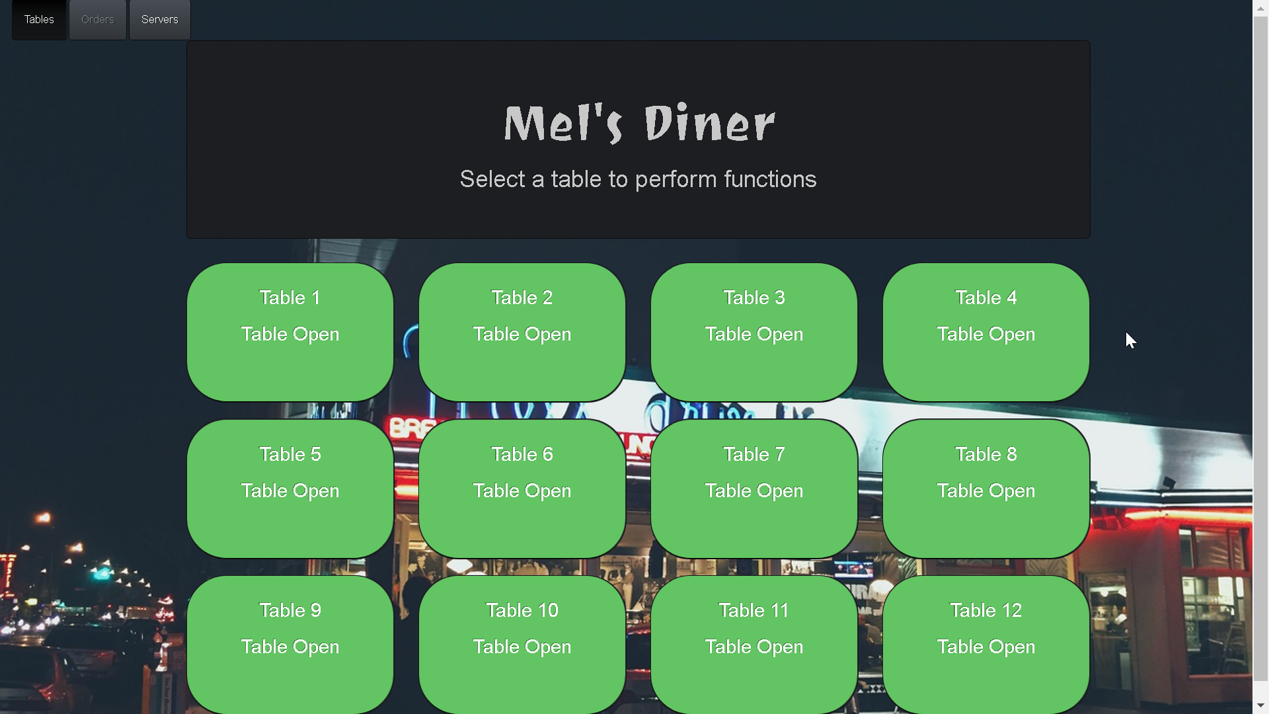
Managing Tables

Slide 6
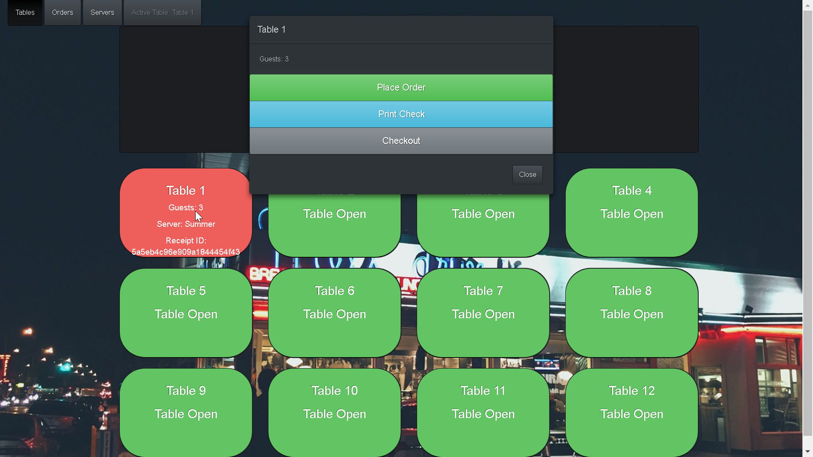
Managing Orders

Slide 7
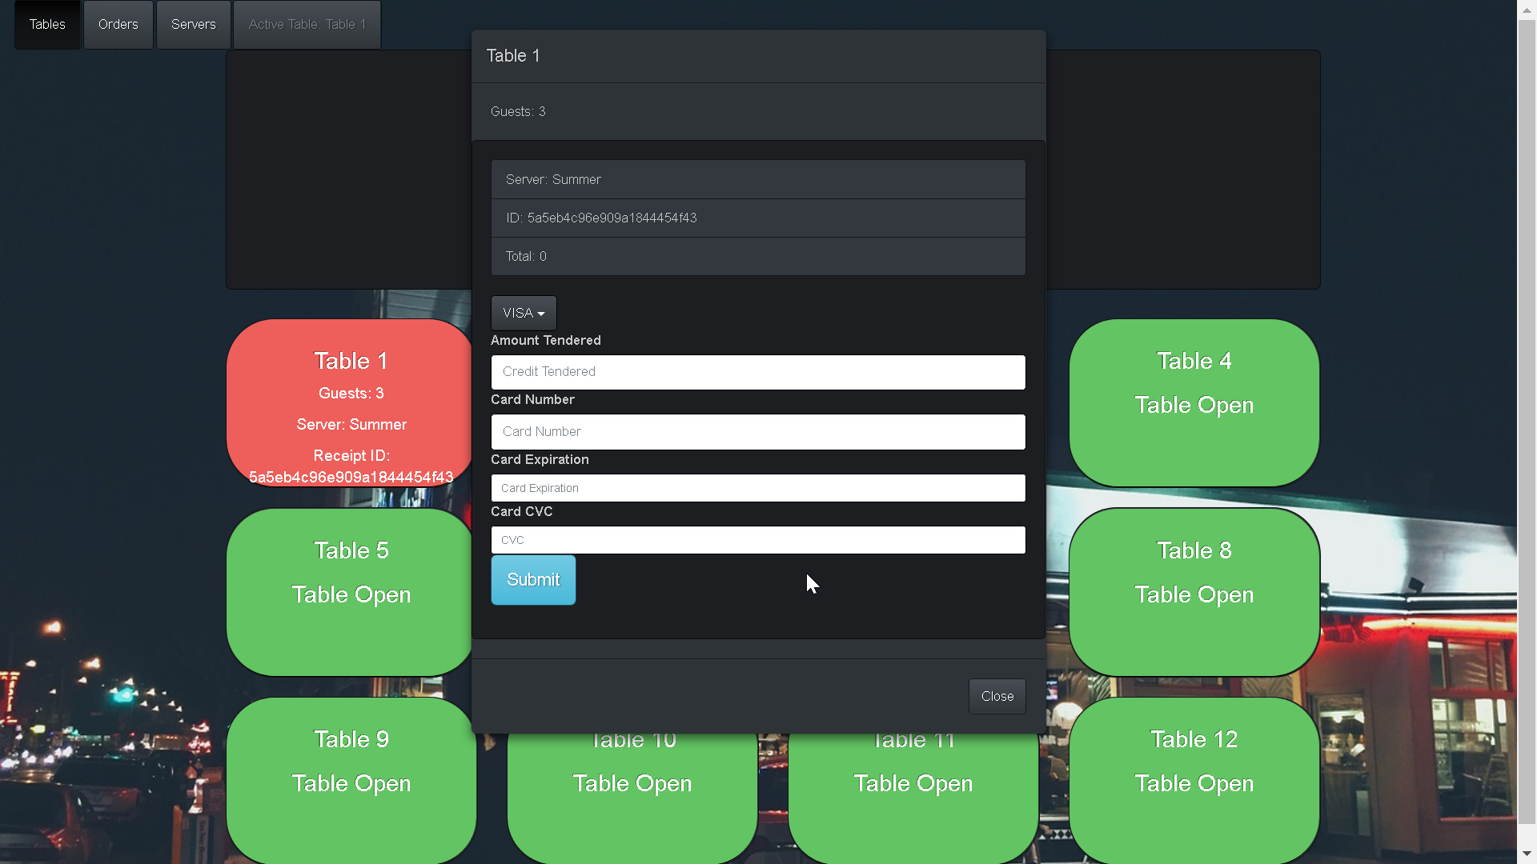
Checking out

Slide 8

Dependencies…
Axios React React-Bootstrap Concurrently Cors MongoDB | Mongoose Express Morgan Nodemon Serve-Favicon

Slide 9



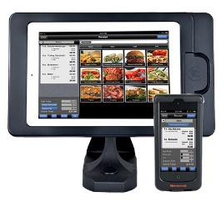
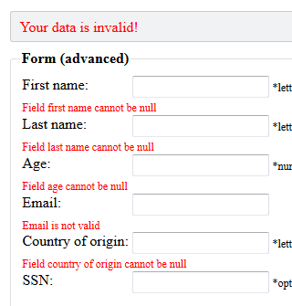
Future Updates…
SMS alert integration for waiting and receipt delivery.
Coupons and Gift cards integration.
Administrative interface to manage service, menu, and employees.
Guest tableside ordering system.
Form and data validation.

